Slide 1






Assessing Performance of Service Delivery Session 4 Global Flagship Course on Health Systems Strengthening: The Challenge of Universal Health Coverage Ian Forde and Nedim Jaganjac World Bank Group

Slide 2
What challenges must the health care system address?

Slide 3
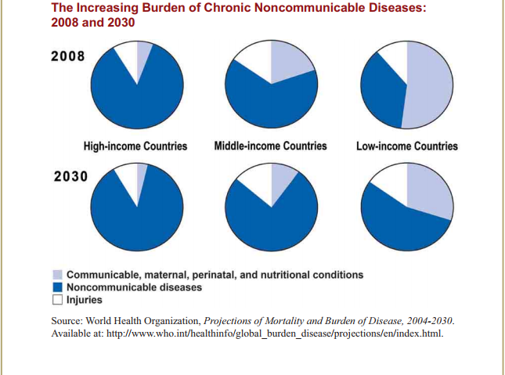
WHO, 2011

Slide 4
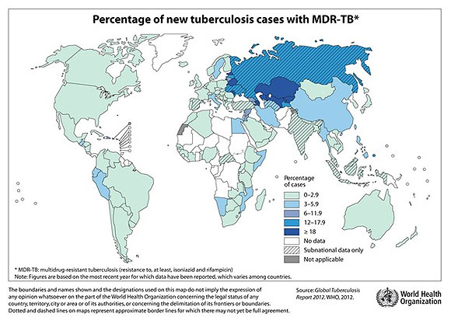

Slide 5
External Challenges: Implications for Service Delivery
Aging
Coordinated care, close monitoring, avoiding unnecessary hospitalization, primary care, home outreach
Prevention, disease and case management, risk factor management, coordinated care, single point of entry, avoidance of unnecessary admissions, home outreach
Change treatment orientation from emphasis on episodic acute care and discrete interventions to providing continuous care
NCDs
Urbanization
Management of risk factors, gate keeping, coordinated referrals
Rising Incomes
Decentralization of specialty care, control of expensive medical technologies, use of intermediary facilities – e.g. ambulatory surgery, day hospitals, remote care
Notes:
Different service delivery model

Slide 6
How well prepared are health care systems to meet these challenges?

Slide 7

Health System Challenge: Many Countries are Ill-prepared to address NCDs and aging populations
Care model
Treatment orientation: emphasis on acute care and discrete interventions
Facility-based; physical consultation
Public health – built with infectious disease orientation
Fragmentation
Uncoordinated and often siloed providers
Lack of integration of preventive, curative and palliative care
Hospital-centric structure (in many countries)
Top heavy – race to the top
Bypassing of PHC
Distorted incentives
Public sector: Low level of effort
Private sector: Provider-induced demand/unnecessary care
Weak focus on quality improvement
Lack of data
Notes:
Fragmentation despite unitary structure of public delivery systems - Mexico
Perceived low quality of primary care providers
Not well prepared for chronic disease
FFS and traditional budgets
Week focus on patient self management

Slide 8
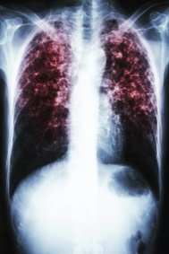


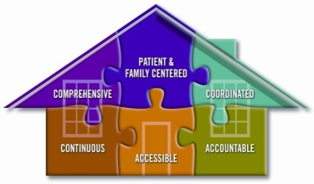

Traditional Delivery System: Uncoordinated Care
TB Vertical Program
NCD Vertical Program
HIV/AIDS Vertical Program
Primary Healthcare
Hospital Care
Source: Adapted from Janett (2017)
Notes:
Problem
Many middle income countries address public health problems with vertical disease-specific programs
The failure to integrate these programs at the community care level creates inefficiency and can exacerbate important gaps in care
Large numbers of patients fail to receive appropriate and needed screening, preventive, acute care, and chronic care health services under this model

Slide 9
Effects of fragmentation or lack of care coordination – low value care
Wrong or inappropriate treatment
Patient “zigzagging” among multiple providers
Unnecessary admissions and readmissions
Increased length of stay
Delay in diagnosis
Adverse events
Patient dissatisfaction
Increased costs
Source: Adapted from Australian Council for Safety and Quality of health care, 2005

Slide 10
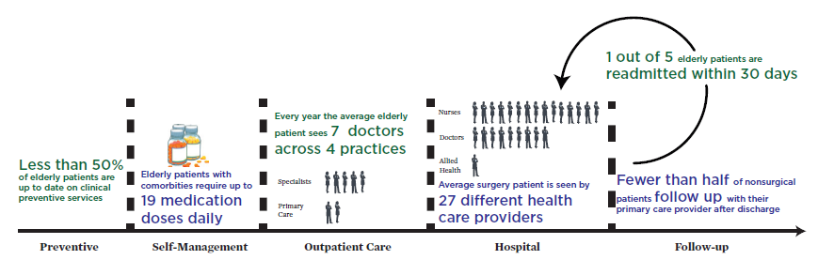
Fragmentation in Practice: Representative timeline of a patient’s experiences in the U.S. health care system
SOURCE: IOM, 2013; Data derived from Boyd et al., 2005; Jencks et al., 2009; Pham et al.,

Slide 11
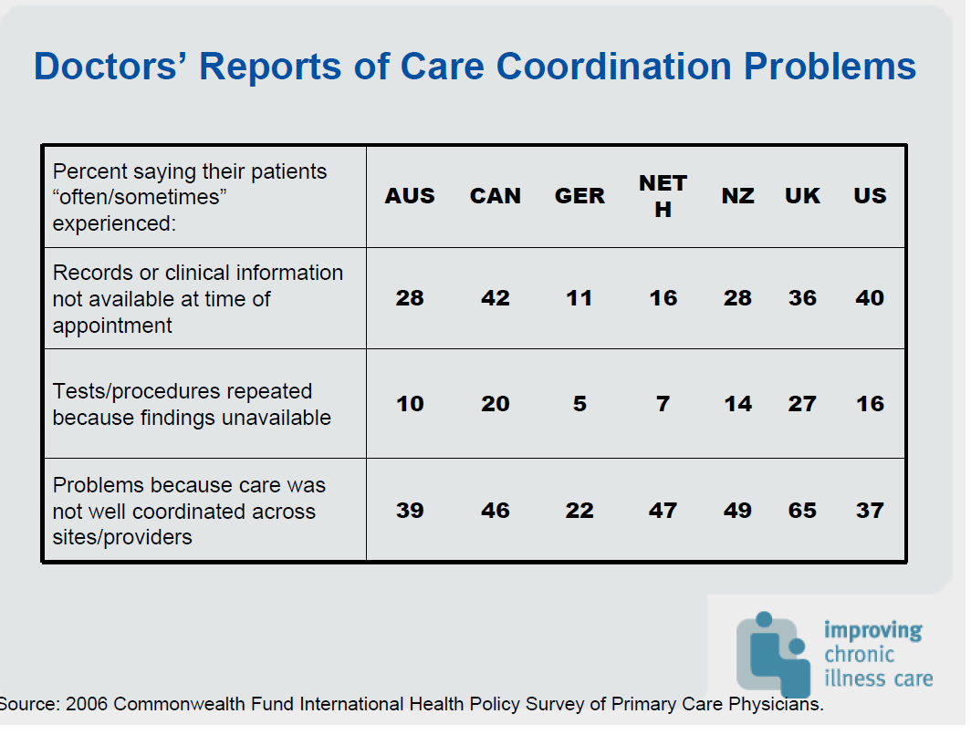
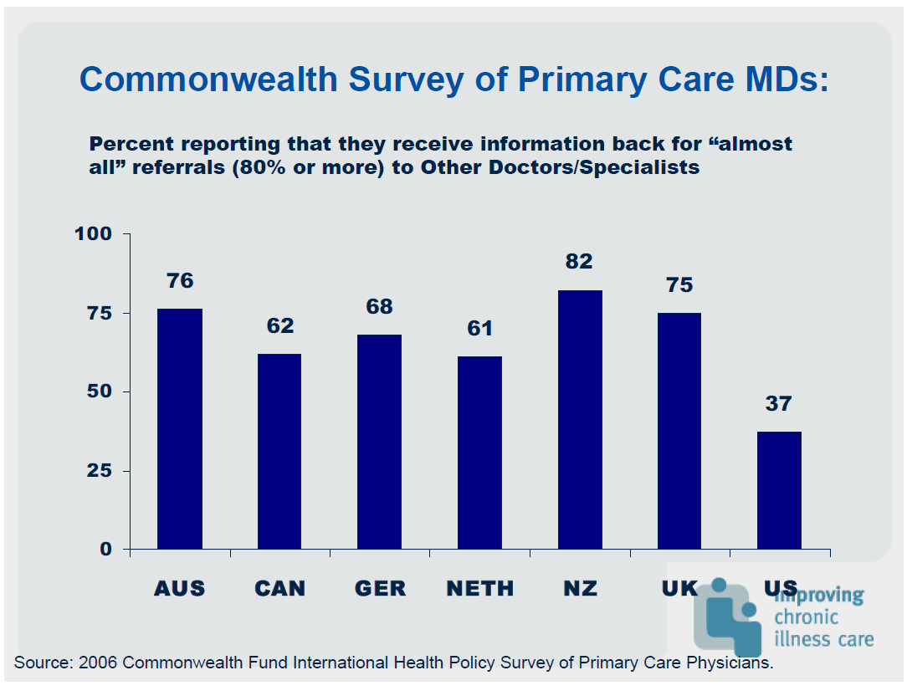
Effects of Care Fragmentation - Provider Perspective, various countries, 2006

Slide 12
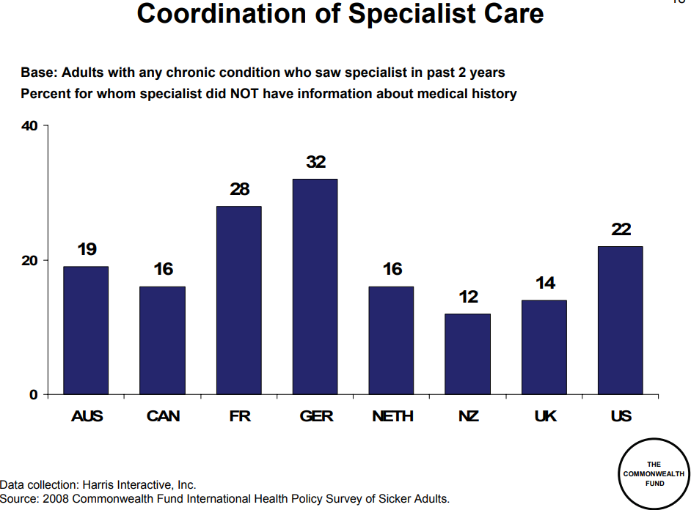
Fragmentation in Practice: Specialty Care Coordination, Various countries

Slide 13
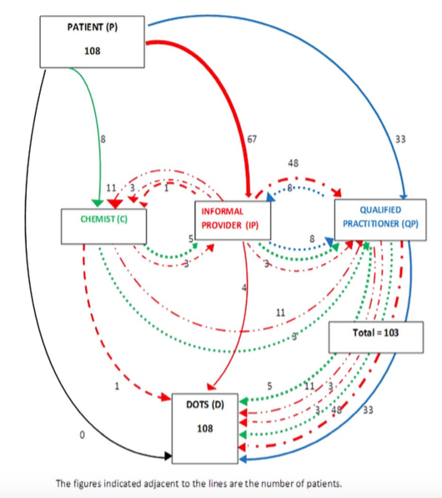
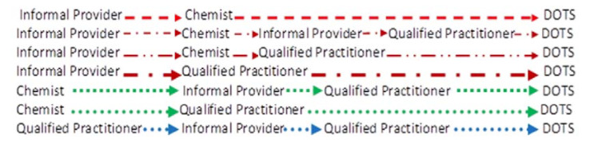
Effects of Fragmentation: Zigzagging for ambulatory care - TB Pathways undertaken by patients to reach the RNTCP (DOTS) facilities in Delhi, 2010 (N=108)
Source: Kapoor et al. (2012)
Notes:
Probably worse for chronic diseases – but lack data from India == China and Central America
How Did the TB Patients Reach DOTS Services in Delhi? A Study of Patient Treatment Seeking Behavior
Objective: To ascertain the number and sequence of providers visited by TB patients before availing treatment services
from DOTS; to describe the duration between onset of symptoms to treatment.
Study design: A cross sectional, qualitative study. Information was gathered through in-depth interviews of TB patients registered during the month of Oct, 2012 for availing TB treatment under the Revised National TB Control Programme from four tuberculosis diagnosis and treatment centers in Delhi.
Results: Out of the 114 patients who registered, 108 participated in the study. The study showed that informal providers and retail chemists were the first point of contact and source of clinical advice for two-third of the patients, while the rest sought medical care from qualified providers directly. Most patients sought medical care from more than two providers, before being diagnosed as TB. Female TB patients and patients with extra-pulmonary TB had long mean duration between onset of symptoms to initiation of treatment (6.3 months and 8.4 months respectively).
Conclusion: The pathways followed by TB patients, illustrated in this study, provide valuable lessons on the importance of different types of providers (both formal and informal) in the health system in a society like India and the delays in the diagnosis and treatment of tuberculosis.

Slide 14
Doing Things Right: We have a fair idea what the sources of inefficiency are, and the magnitudes can be measured
Sources of inefficiency
Potential value – LICs and LMICs¹, USD
Total health spending
Wrong staff mix
Absenteeism
Share of waste
Costly staff
Human resources
$ 20 – 38 Bn
Gx underuse
Low drug quality
Over-Rx
Counterfeit
Over-priced Gx
Medicine
$ 7 – 13 Bn
Hospital size
Avoidable admission
Length of stay
Hospitals
$ 12 – 27 Bn
Corruption
Fraud
Excessive procedures
Equipment overuse
Leakages
$ 13 – 27 Bn
Medical error
Poor quality care
SOURCE: “Tackling Wasteful Spending on Health” OECD 2017, “Improving health system efficiency as a means of moving towards universal coverage” World Health Report 2010
1 Approximated using average estimates of potential efficiency savings (% of total health spending) for LICs and MICs

Slide 15

A closer look at primary care in Armenia

Slide 16
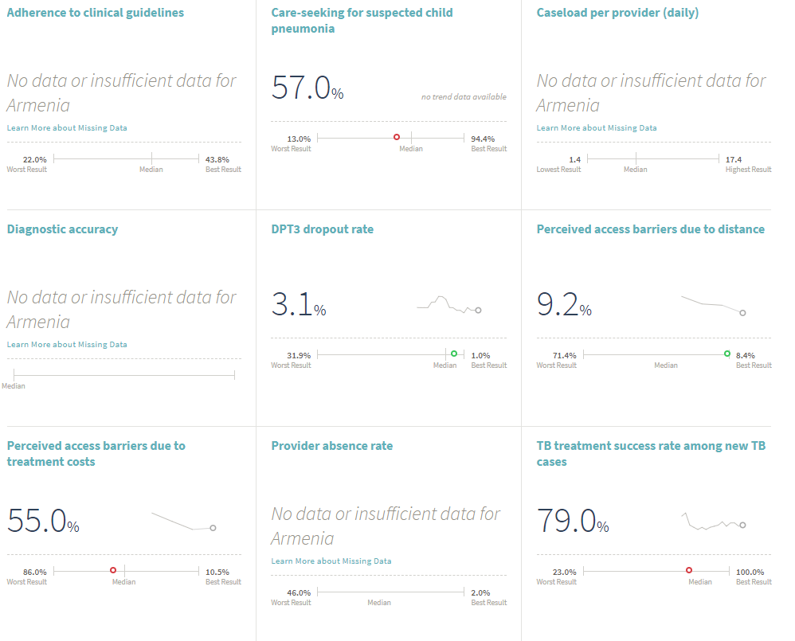
Notes:
This illustration depicts the current, fragmented healthcare system: services working independently with a “part” of a person, chaotic and isolated, with episodic care. I want to emphasize that every one of us is doing the best job we can within our current system.
Emphasize that people aren’t doing a BAD job…it could better – the system is doing a bad job

Slide 17
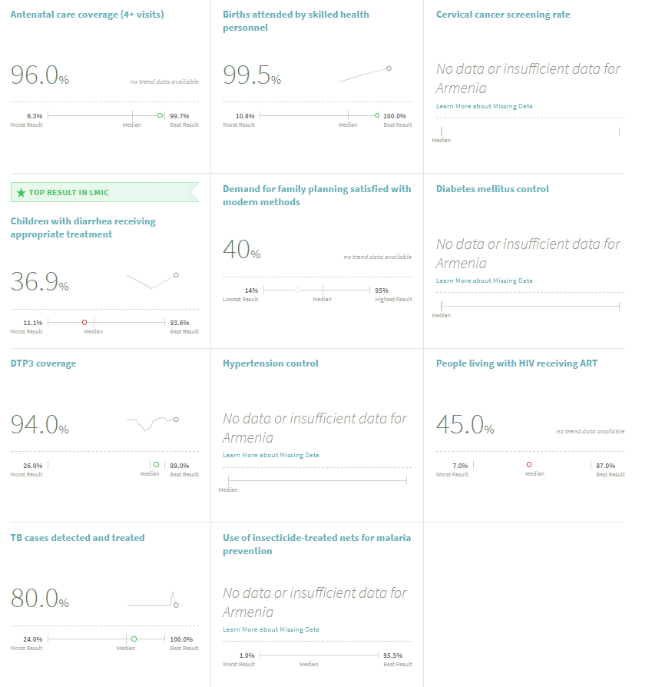
Notes:
This illustration depicts the current, fragmented healthcare system: services working independently with a “part” of a person, chaotic and isolated, with episodic care. I want to emphasize that every one of us is doing the best job we can within our current system.
Emphasize that people aren’t doing a BAD job…it could better – the system is doing a bad job

Slide 18
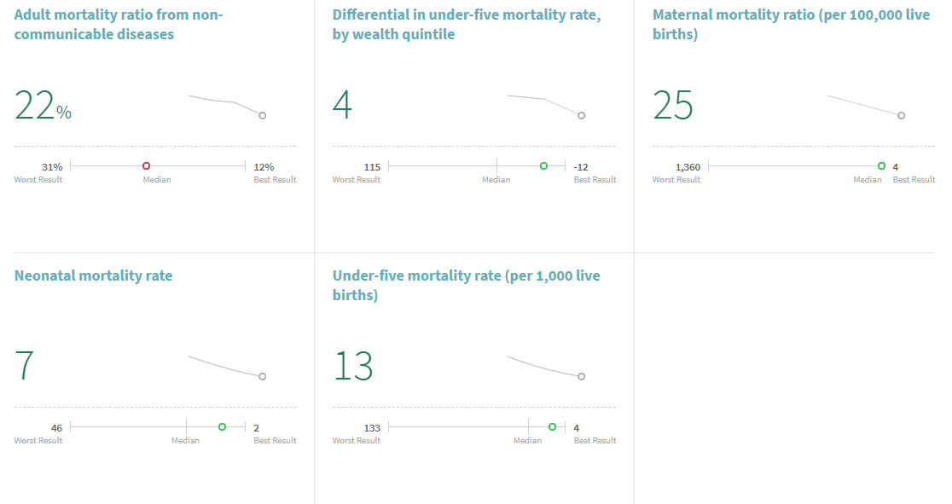
Notes:
This illustration depicts the current, fragmented healthcare system: services working independently with a “part” of a person, chaotic and isolated, with episodic care. I want to emphasize that every one of us is doing the best job we can within our current system.
Emphasize that people aren’t doing a BAD job…it could better – the system is doing a bad job

Slide 19
Performance Measurement…
… is an opportunity for securing health system improvement and accountability
… aims to improve the quality of decisions made by all actors within the health system
… requires improvements in data collection, analytical methodologies, policy response
… requires the active leadership of government
… should pay attention to the political and organizational context within which data are collected, analysed and disseminated
Definitions of performance indicators should be clear, consistent and fit into an agreed conceptual framework.

Slide 20
What are the options for modernizing health care systems?

Slide 21
Paradigm Shift: Toward a New Service Delivery Model
Conventional Care |  | People-centered, Coordinated Care
Reactive: Focus on illness and cure |  | Proactive: Anticipate and focus on health needs, disease control and prevention
Episodic: Patient–provider relationship limited to the moment of consultation |  | Longitudinal: Enduring personal relationship between patient and providers
Focus on acute curative care/discrete interventions |  | Comprehensive, continuous and person-centered care; chronic disease management
Responsibility limited to advice to individual patient at moment of consultation |  | Responsibility for care health along the life cycle and for a defined population
Users are recipients of health/medical interventions |  | People are partners in managing their own health; their preferences are integrated into care planning
Disjointed care: fragmented “stand alone” facilities and programs |  | Clinical and organizational integration; strong communication across provider levels
Individual physician and hospital-based |  | Team and network-based
Incentives for volume-based care/unnecessary care (volume and complexity of care, not necessarily the right care) |  | Incentives for care management, population health, quality and efficiency
Author’s Elaboration

Slide 22
Emerging Evidence From New Delivery Models
Patient Compliance, Patient Satisfaction, Access, Quality, Efficiency
Increases in:
Decreases in:
Unnecessary hospitalizations and readmissions
Specific improvements in:
Follow-up care
Continuous care
Reduction in practice variations
Particularly for patients with chronic illnesses
Notes:
Mixed bag – given the newness of the models and methodological difficulties in isolating model components and roll-out proceses
Generallyhas done well in terms of: Lowering hospitalization rates, improving clinical processes, improved outcomes and patient satisfaction
The jury is still out on cost savings --- inconclusive evidence on long term impact of cost containment

Slide 23
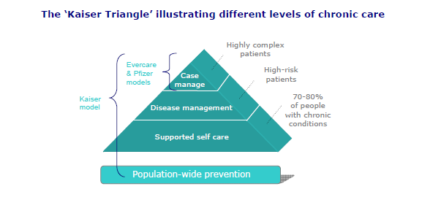
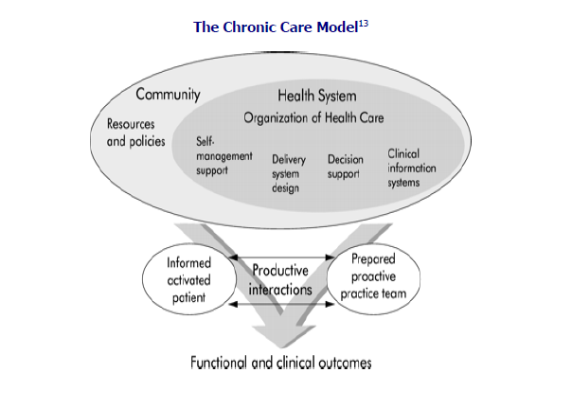
Broad System models (to reorient care toward
addressing chronic conditions)
Stroebel RJ, Gloor B, Freytag S et al. Adapting the chronic care model to treat chronic illness at a free
medical clinic. J Health Care Poor Underserved 2005; 16(2): 286-96.

Slide 24





Transition Care Model: Two illustrations
HOME
COMM-UNITY
PHC
Primary Care
Hospitals
High-quality transitions for providers & patients
Homes and Commu-
nities
Hospi-tals
Specia-lists
Specialists
Three Key Transitions Domains
Hospital – Primary care
Hospital – Home/Community
Specialist – Primary care

Slide 25
WHICH COVERAGE TO IMPROVE?
UHC
Health Status
Emphasize PHC and public health?
Emphasize hospitalization insurance/catastrophic spending?
Current Performance
Financial Protection

Slide 26
The CHOICE matters: A and B give different outcomes
Health Status
A
UHC
Full coverage level
of spend
B
Increase spending
on the road to UHC
Current Performance
Starting level of spend
Financial Protection

Slide 27
Concluding Thoughts
A Health System is made up of multiple, interdependent and interacting sectors, organizations and actors
A “whole system” perspective is essential in implementing organizational reforms towards UHC
Micro level organizational reform is just as important as macro-level strategies towards improved service delivery
Capacity of organization to implement changes is often neglected

Slide 28
Thank you!

